Slide 1
Clustering – Part 2
Hierarchical Clustering
Prof. Navneet Goyal
BITS, Pilani
Notes:
Dr. Navneet Goyal, BITS,Pilani

Slide 2
Hierarchical Clustering Algorithms
Build a cluster hierarchy called “dendrogram”
Dendrogram can be cut at any level to get desired number of clusters
Dendrogram is like a tree with leaves representing finest grained clusters (point clusters) and root representing coarsest grained cluster (all points in a single cluster)
Non-trivial clustering is obtained somewhere in between the
Notes:
Dr. Navneet Goyal, BITS,Pilani

Slide 3


Hierarchical Clustering
Produces a set of nested clusters organized as a hierarchical tree
Can be visualized as a “dendrogram”
  A tree like diagram that records the sequences of merges or splits
Notes:
Dr. Navneet Goyal, BITS,Pilani

Slide 4
Hierarchical Clustering Algorithms
Agglomerative (bottom-up) or Divisive (top-down)
Agglomerative – start with each point in it its own cluster
Divisive – start with all points in a single cluster
Notes:
Dr. Navneet Goyal, BITS,Pilani

Slide 5
Hierarchical Clustering
Step 0
Step 1
Step 2
Step 3
Step 4
agglomerative
(AGNES)
a
a b
b
a b c d e
c
c d e
d
d e
e
divisive
(DIANA)
Step 4
Step 3
Step 2
Step 1
Step 0
Notes:
Dr. Navneet Goyal, BITS,Pilani

Slide 6
Hierarchical Algorithms
Single Link (MIN)
MST Single Link
Complete Link (MAX)
Average Link (Group Average)
Centroid Agglomerative Clustering
Ward’s Criterion
These algorithms differ in the way the similarity measure is defined!!
Notes:
Dr. Navneet Goyal, BITS,Pilani

Slide 7
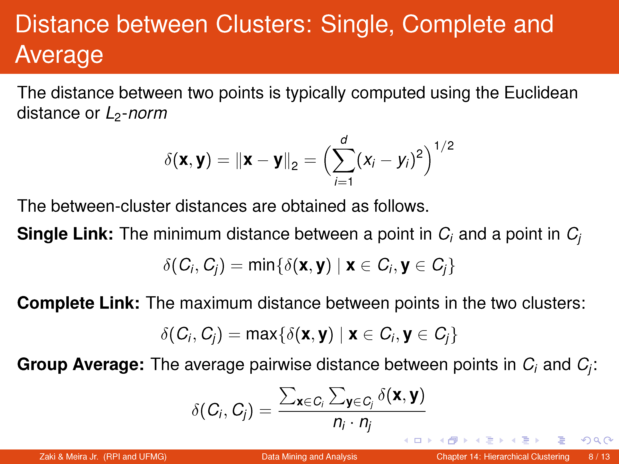

Slide 8
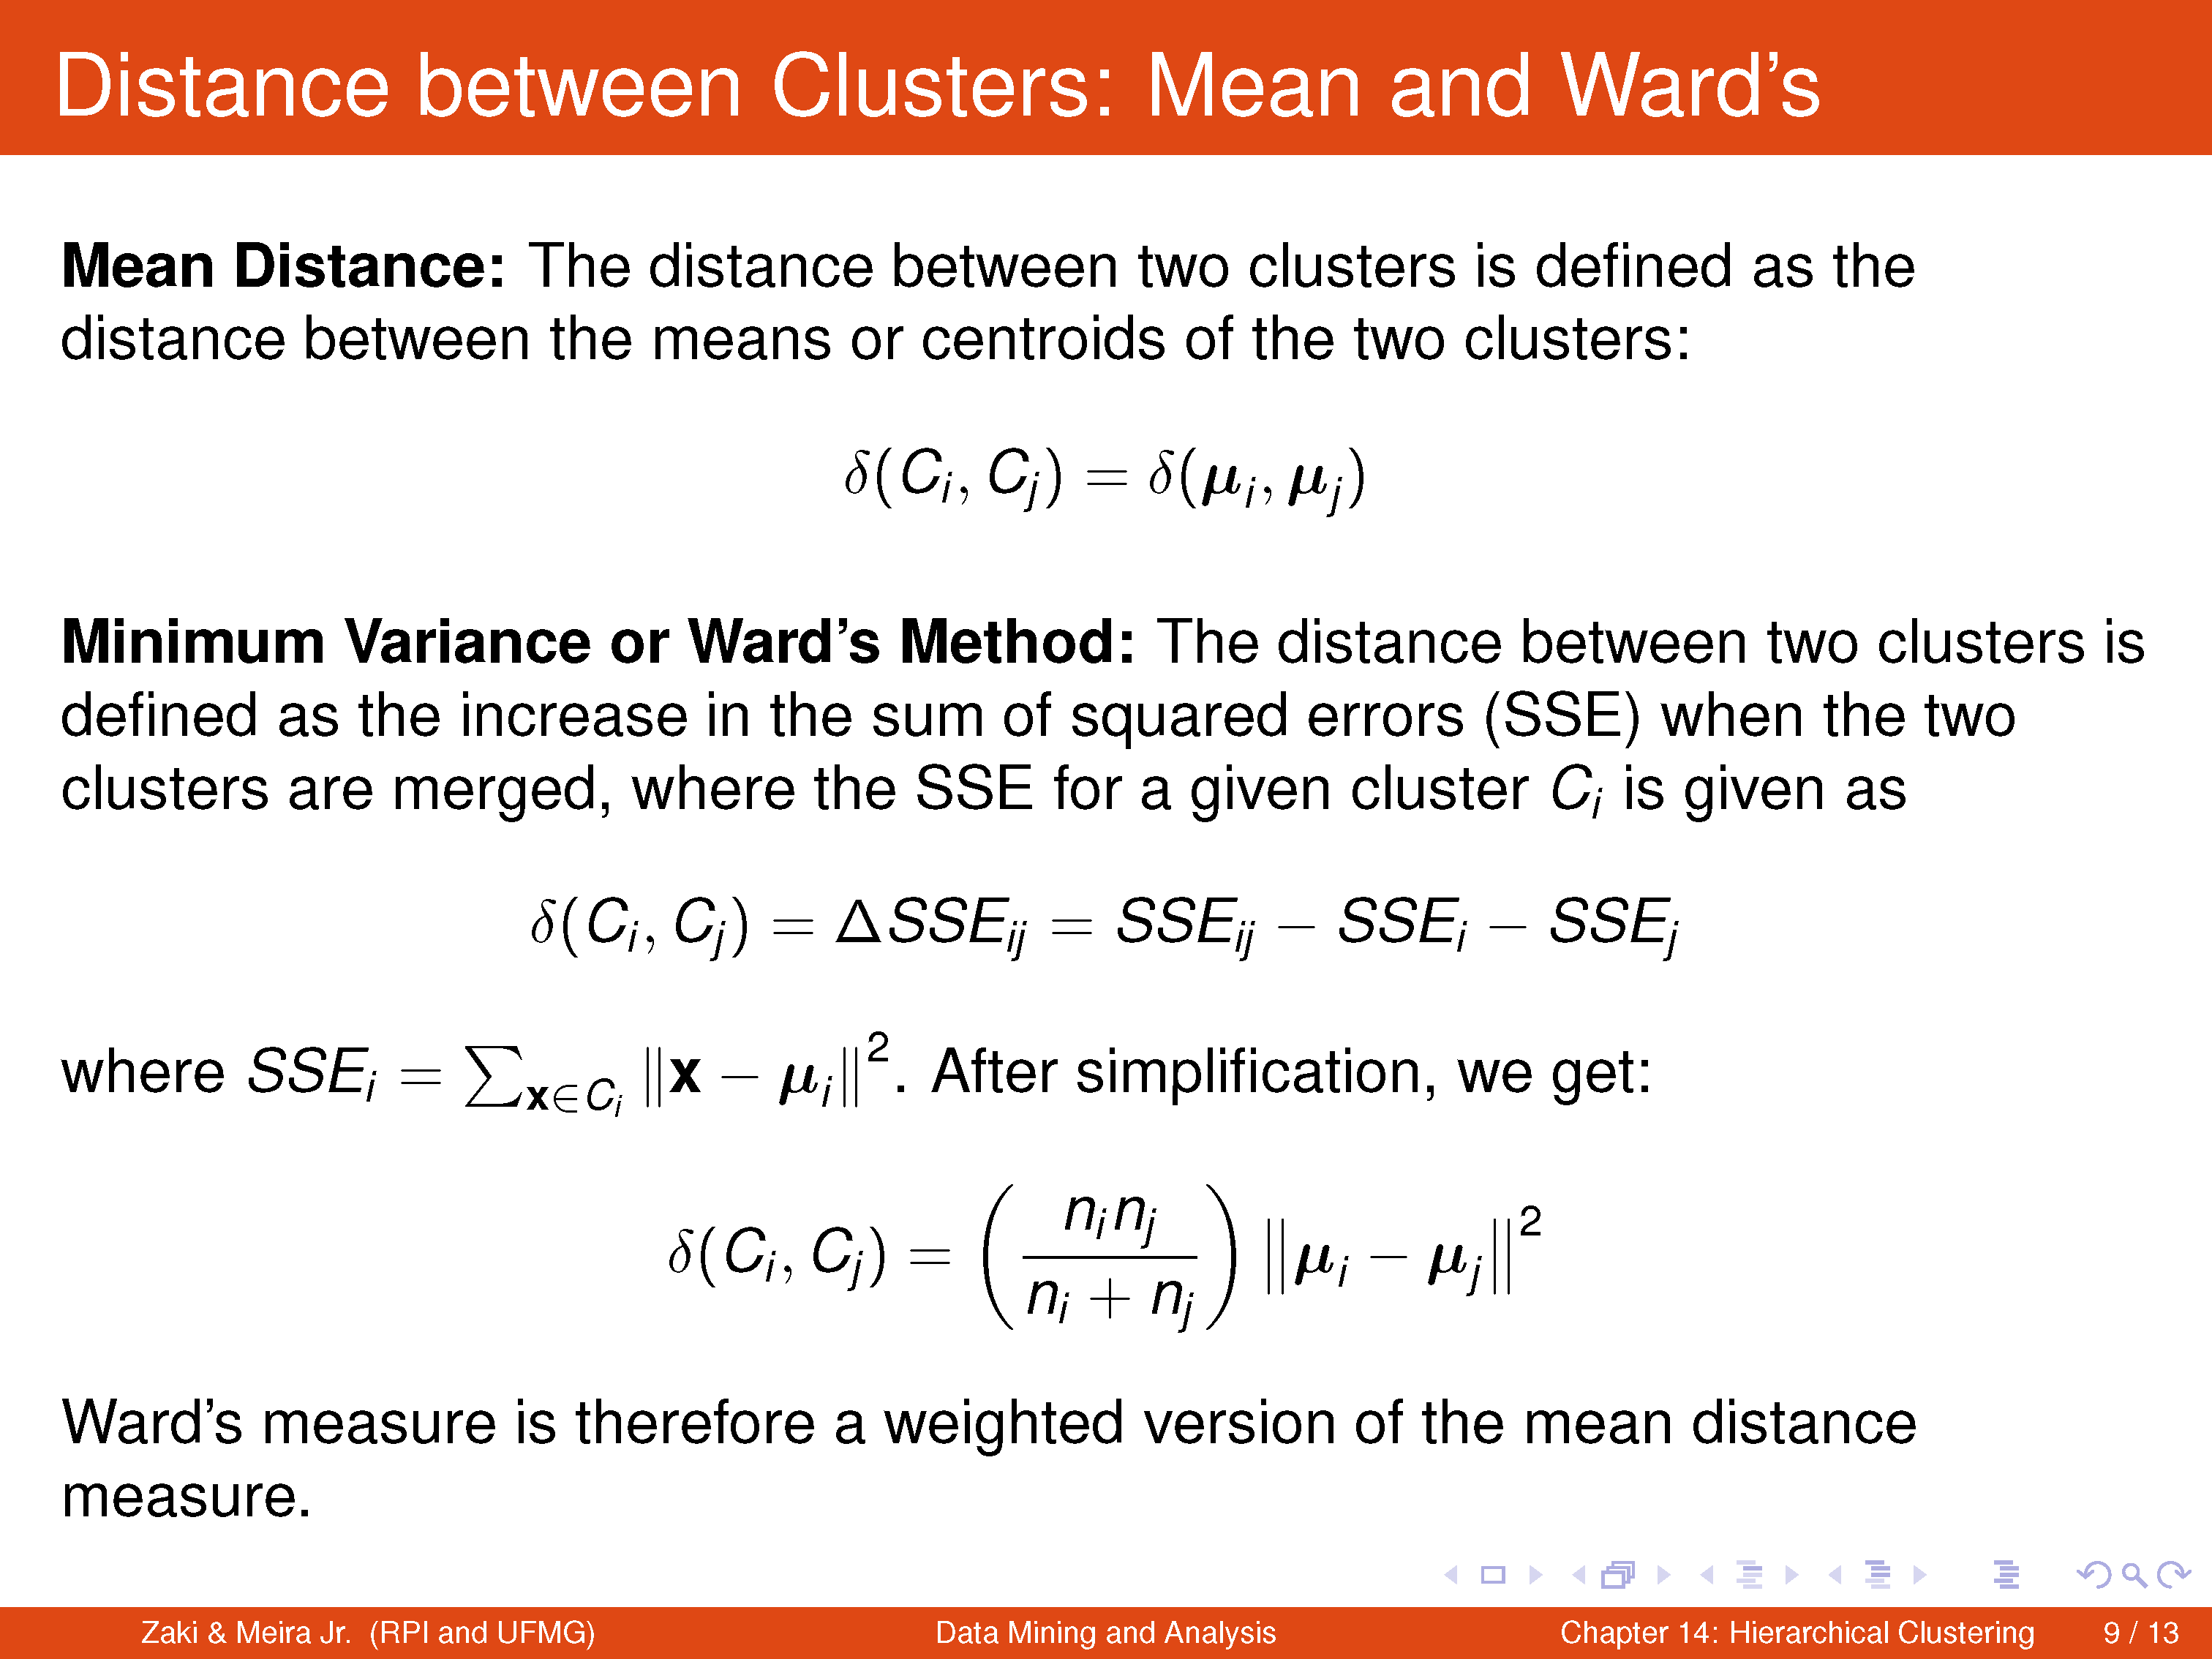

Slide 9
Single Linkage Clustering
Gives more importance to regions where clusters are closest, neglecting the overall structure of clusters
Local similarity based clustering – capable of effectively clustering non-elliptical, elongated clusters
Notes:
Dr. Navneet Goyal, BITS,Pilani

Slide 10
Algorithm
Given a set of N items to be clustered, and an NxN distance (or similarity) matrix, the basic process of single linkage clustering is as follows:
1.Start by assigning each item to its own cluster, so that if we have N items, we now have N clusters, each containing just one item. Let the distances (similarities) between the clusters equal the distances (similarities) between the items they contain.
2.Find the closest (most similar) pair of clusters and merge them into a single cluster, so that now you have one less cluster.
3.Compute distances (similarities) between the new cluster and each of the old clusters.
4.Repeat steps 2 and 3 until all items are clustered into a single cluster of size N.
Notes:
Dr. Navneet Goyal, BITS,Pilani

Slide 11
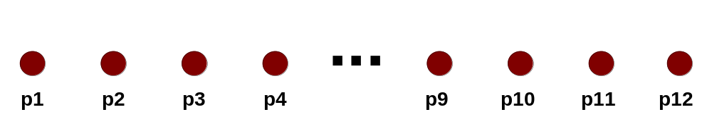
Starting Situation
Start with clusters of individual points and a proximity matrix
p1
p2
p3
p4
p5
. . .
p1
p2
p3
p4
p5
.
.
.
Proximity Matrix
Notes:
Dr. Navneet Goyal, BITS,Pilani

Slide 12
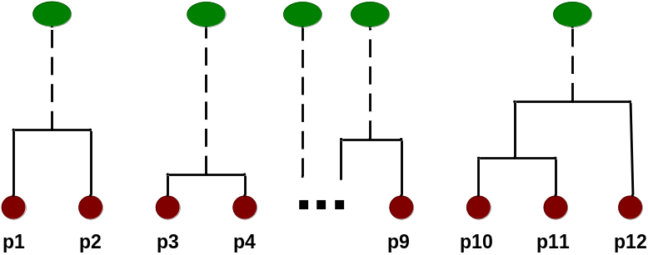
Intermediate Situation
After some merging steps, we have some clusters
C1
C2
C3
C4
C5
C1
C2
C3
C3
C4
C4
C5
C1
Proximity Matrix
C2
C5
Notes:
Dr. Navneet Goyal, BITS,Pilani

Slide 13

Intermediate Situation
We want to merge the two closest clusters (C2 and C5) and update the proximity matrix.
C1
C2
C3
C4
C5
C1
C2
C3
C3
C4
C4
C5
C1
Proximity Matrix
C2
C5
Notes:
Dr. Navneet Goyal, BITS,Pilani

Slide 14

After Merging
The question is “How do we update the proximity matrix?”
C2 U C5
C1
C3
C4
C1
?
C2 U C5
? ? ? ?
C3
C3
?
C4
C4
?
Proximity Matrix
C1
C2 U C5
Notes:
Dr. Navneet Goyal, BITS,Pilani

Slide 15
How to Define Inter-Cluster Similarity?
p1
p2
p3
p4
p5
. . .
p1
Similarity?
p2
p3
p4
MIN
MAX
Group Average
Distance Between Centroids
Other methods driven by an objective function
  Ward’s Method uses squared error
p5
.
.
.
Proximity Matrix
Notes:
Dr. Navneet Goyal, BITS,Pilani

Slide 16
How to Define Inter-Cluster Similarity?
p1
p2
p3
p4
p5
. . .
p1
p2
p3
p4
MIN
MAX
Group Average
Distance Between Centroids
Other methods driven by an objective function
  Ward’s Method uses squared error
p5
.
.
.
Proximity Matrix
Notes:
Dr. Navneet Goyal, BITS,Pilani

Slide 17
How to Define Inter-Cluster Similarity?
p1
p2
p3
p4
p5
. . .
p1
p2
p3
MIN
MAX
Group Average
Distance Between Centroids
Other methods driven by an objective function
  Ward’s Method uses squared error
p4
p5
.
.
.
Proximity Matrix
Notes:
Dr. Navneet Goyal, BITS,Pilani

Slide 18
How to Define Inter-Cluster Similarity?
p1
p2
p3
p4
p5
. . .
p1
p2
p3
MIN
MAX
Group Average
Distance Between Centroids
Other methods driven by an objective function
  Ward’s Method uses squared error
p4
p5
.
.
.
Proximity Matrix
Notes:
Dr. Navneet Goyal, BITS,Pilani

Slide 19
How to Define Inter-Cluster Similarity?
p1
p2
p3
p4
p5
. . .
p1
×
×
p2
p3
MIN
MAX
Group Average
Distance Between Centroids
Other methods driven by an objective function
  Ward’s Method uses squared error
p4
p5
.
.
.
Proximity Matrix
Notes:
Dr. Navneet Goyal, BITS,Pilani

Slide 20
An Example
A hierarchical clustering of distances in kilometers between some Italian cities. The method used is single-linkage.
Notes:
Dr. Navneet Goyal, BITS,Pilani

Slide 21
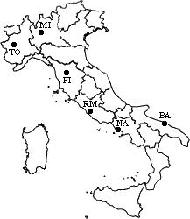
Input distance matrix (L = 0 for all the clusters):
c | BA | FI | MI | NA | RM | TO
BA | 0 | 662 | 877 | 255 | 412 | 996
FI | 662 | 0 | 295 | 468 | 268 | 400
MI | 877 | 295 | 0 | 754 | 564 | 138
NA | 255 | 468 | 754 | 0 | 219 | 869
RM | 412 | 268 | 564 | 219 | 0 | 669
TO | 996 | 400 | 138 | 869 | 669 | 0
The nearest pair of cities is MI and TO, at distance 138. These are merged into a single cluster called "MI/TO". The level of new cluster is L(MI/TO) = 138
Notes:
Dr. Navneet Goyal, BITS,Pilani

Slide 22
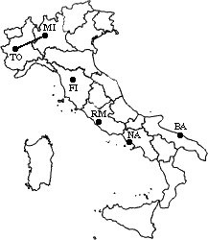
 | BA | FI | MI/TO | NA | RM
BA | 0 | 662 | 877 | 255 | 412
FI | 662 | 0 | 295 | 468 | 268
MI/TO | 877 | 295 | 0 | 754 | 564
NA | 255 | 468 | 754 | 0 | 219
RM | 412 | 268 | 564 | 219 | 0
Now, min d(i,j) = d(NA,RM) = 219 => merge NA and RM into a new cluster called NA/RM
L(NA/RM) = 219
Notes:
Dr. Navneet Goyal, BITS,Pilani

Slide 23
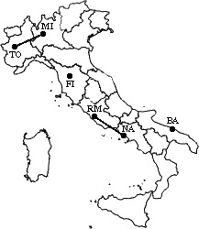
 | BA | FI | MI/TO | NA/RM
BA | 0 | 662 | 877 | 255
FI | 662 | 0 | 295 | 268
MI/TO | 877 | 295 | 0 | 564
NA/RM | 255 | 268 | 564 | 0
min d(i,j) = d(BA,NA/RM) = 255 => merge BA and NA/RM into a new cluster called BA/NA/RM
L(BA/NA/RM) = 474
Notes:
Dr. Navneet Goyal, BITS,Pilani

Slide 24
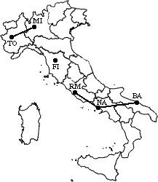
 | BA/NA/RM | FI | MI/TO
BA/NA/RM | 0 | 268 | 564
FI | 268 | 0 | 295
MI/TO | 564 | 295 | 0
min d(i,j) = d(BA/NA/RM,FI) = 268 => merge BA/NA/RM and FI into a new cluster called BA/FI/NA/RM
L(BA/FI/NA/RM) = 742
Notes:
Dr. Navneet Goyal, BITS,Pilani

Slide 25
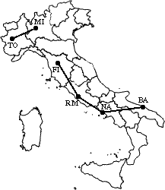
 | BA/FI/NA/RM | MI/TO
BA/FI/NA/RM | 0 | 295
MI/TO | 295 | 0
Finally, we merge the last two clusters at level 1037.
Notes:
Dr. Navneet Goyal, BITS,Pilani

Slide 26
Strengths of Hierarchical Clustering
Do not have to assume any particular number of clusters
  Any desired number of clusters can be obtained by ‘cutting’ the dendogram at the proper level
They may correspond to meaningful taxonomies
  Example in biological sciences (e.g., animal kingdom, phylogeny reconstruction, …)
Notes:
Dr. Navneet Goyal, BITS,Pilani

Slide 27
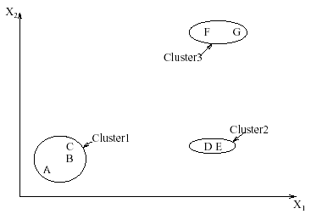
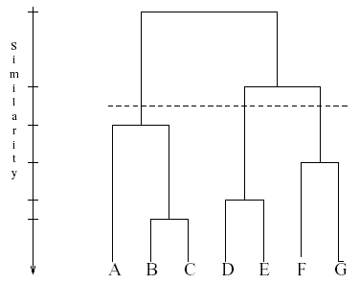
Interpreting Dendrograms
Clusters Dendrogram
Notes:
Dr. Navneet Goyal, BITS,Pilani

Slide 28
Advantages
Single linkage is best suited to detect lined structure
Invariant against monotonic transformation of the dissimilarities or similarities. For example, the results do not change, if the dissimilarities or similarities are squared, or if we take the log.
Intuitive
Notes:
Dr. Navneet Goyal, BITS,Pilani

Slide 29
Agglomerative Example
 | A | B | C | D | E
A | 0 | 1 | 2 | 2 | 3
B | 1 | 0 | 2 | 4 | 3
C | 2 | 2 | 0 | 1 | 5
D | 2 | 4 | 1 | 0 | 3
E | 3 | 3 | 5 | 3 | 0
A
B
E
C
D
Threshold of
1
2
3
4
5
A
B
C
D
E
Notes:
Dr. Navneet Goyal, BITS,Pilani

Slide 30
MST Example
A
B
 | A | B | C | D | E
A | 0 | 1 | 2 | 2 | 3
B | 1 | 0 | 2 | 4 | 3
C | 2 | 2 | 0 | 1 | 5
D | 2 | 4 | 1 | 0 | 3
E | 3 | 3 | 5 | 3 | 0
E
C
D
Notes:
Dr. Navneet Goyal, BITS,Pilani

Slide 31
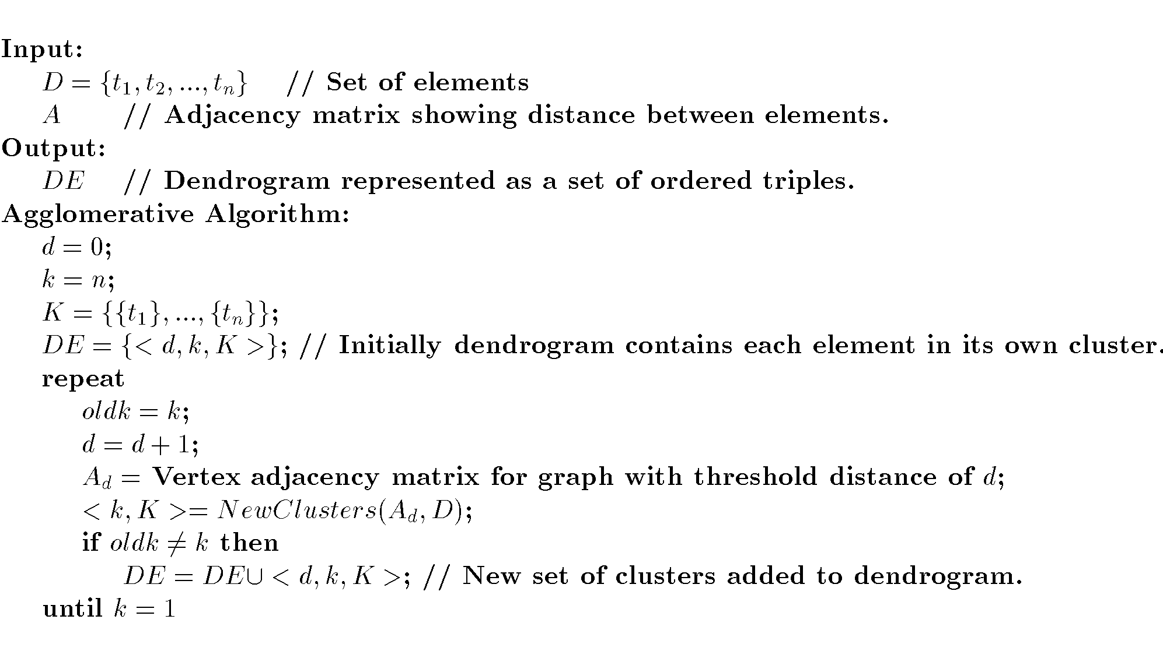
Agglomerative Algorithm
Notes:
Dr. Navneet Goyal, BITS,Pilani

Slide 32
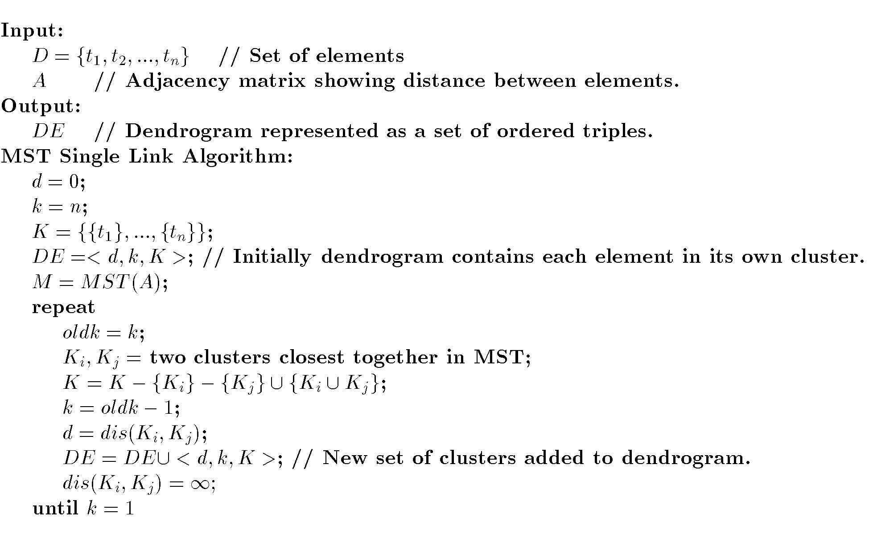
MST Single Link Algorithm
Notes:
Dr. Navneet Goyal, BITS,Pilani

Slide 33
Three Methods Illustrated
complete-link algorithm
g1
g2
?
……
Single-link algorithm
average-link algorithm
Notes:
Dr. Navneet Goyal, BITS,Pilani

Slide 34
Hierarchical: Single Link
cluster similarity = similarity of two most similar members
- Potentially long and skinny clusters
Notes:
Dr. Navneet Goyal, BITS,Pilani
I will start by motivating the work
next describe the Novel algorithm we developed
and then describe the experimental evaluation and present our results

Slide 35
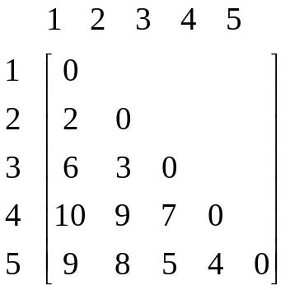
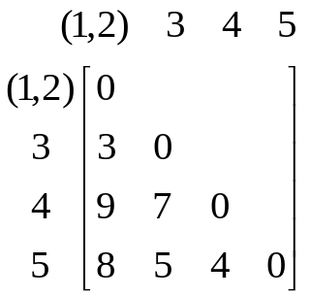
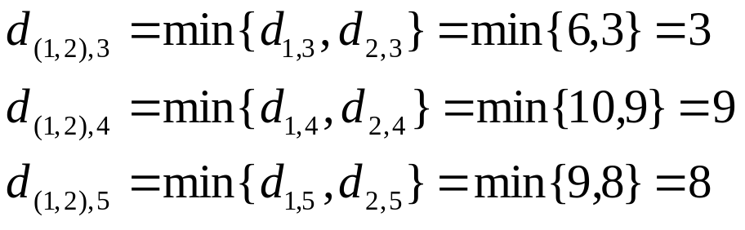
Example: single link
5
4
3
2
1
Notes:
Dr. Navneet Goyal, BITS,Pilani

Slide 36
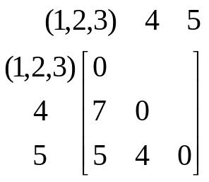
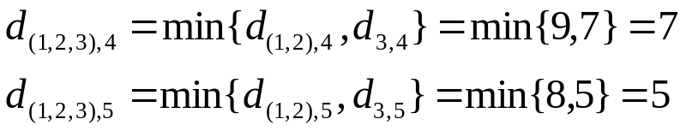
Example: single link
5
4
3
2
1
Notes:
Dr. Navneet Goyal, BITS,Pilani

Slide 37

Example: single link
5
4
3
2
2
1
Notes:
Dr. Navneet Goyal, BITS,Pilani

Slide 38
Hierarchical: Complete Link
cluster similarity = similarity of two least similar members
+ tight clusters
Notes:
Dr. Navneet Goyal, BITS,Pilani
I will start by motivating the work
next describe the Novel algorithm we developed
and then describe the experimental evaluation and present our results

Slide 39
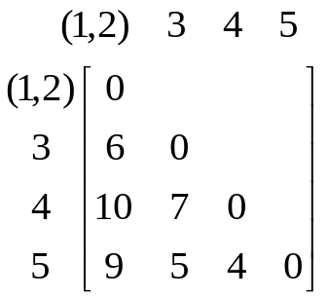
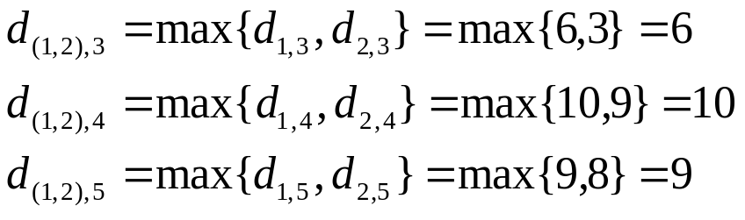
Example: complete link
5
4
3
2
2
1
Notes:
Dr. Navneet Goyal, BITS,Pilani

Slide 40
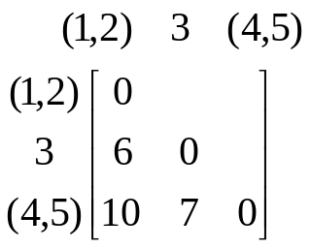
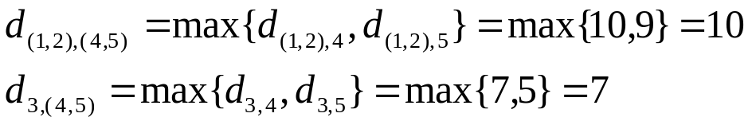
Example: complete link
5
4
3
2
1
Notes:
Dr. Navneet Goyal, BITS,Pilani

Slide 41

Example: complete link
5
4
3
2
1
Notes:
Dr. Navneet Goyal, BITS,Pilani

Slide 42
Hierarchical: Average Link
cluster similarity = average similarity of all pairs
+ tight clusters
Notes:
Dr. Navneet Goyal, BITS,Pilani
I will start by motivating the work
next describe the Novel algorithm we developed
and then describe the experimental evaluation and present our results

Slide 43
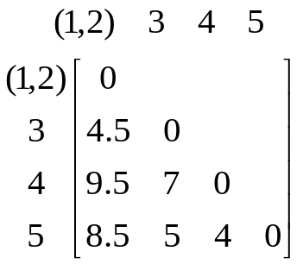
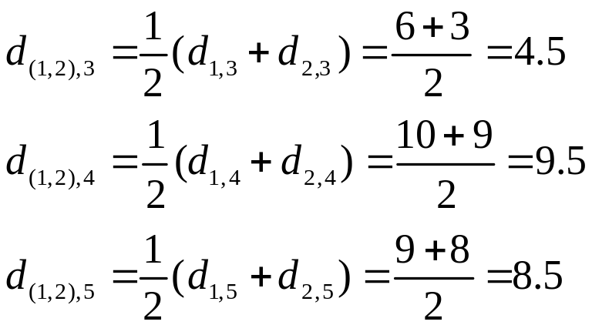
Example: average link
5
4
3
2
1
Notes:
Dr. Navneet Goyal, BITS,Pilani

Slide 44
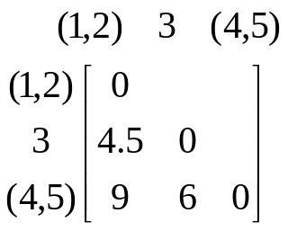
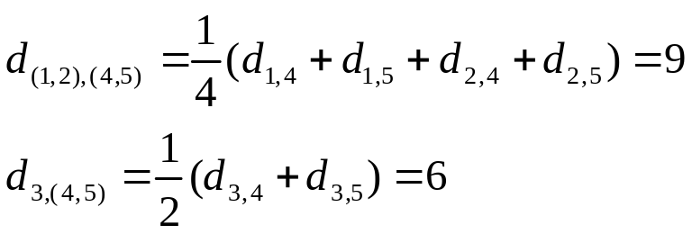
Example: average link
5
4
3
2
1
Notes:
Dr. Navneet Goyal, BITS,Pilani

Slide 45
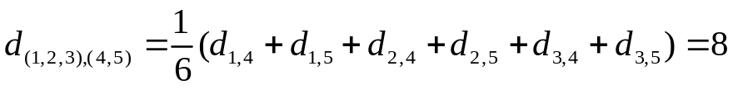
Example: average link
5
4
3
2
1
Notes:
Dr. Navneet Goyal, BITS,Pilani

Slide 46
Other Approaches to Clustering
Density-based methods
  Based on connectivity and density functions
  Filter out noise, find clusters of arbitrary shape
Notes:
Dr. Navneet Goyal, BITS,Pilani

